Slide 1
Biodiversity at Risk: Insights from U.S. National Parks
Analyzing conservation trends and species observations across four major national parks to guide preservation efforts.
Lade Ogundare
July 11, 2025

Slide 2




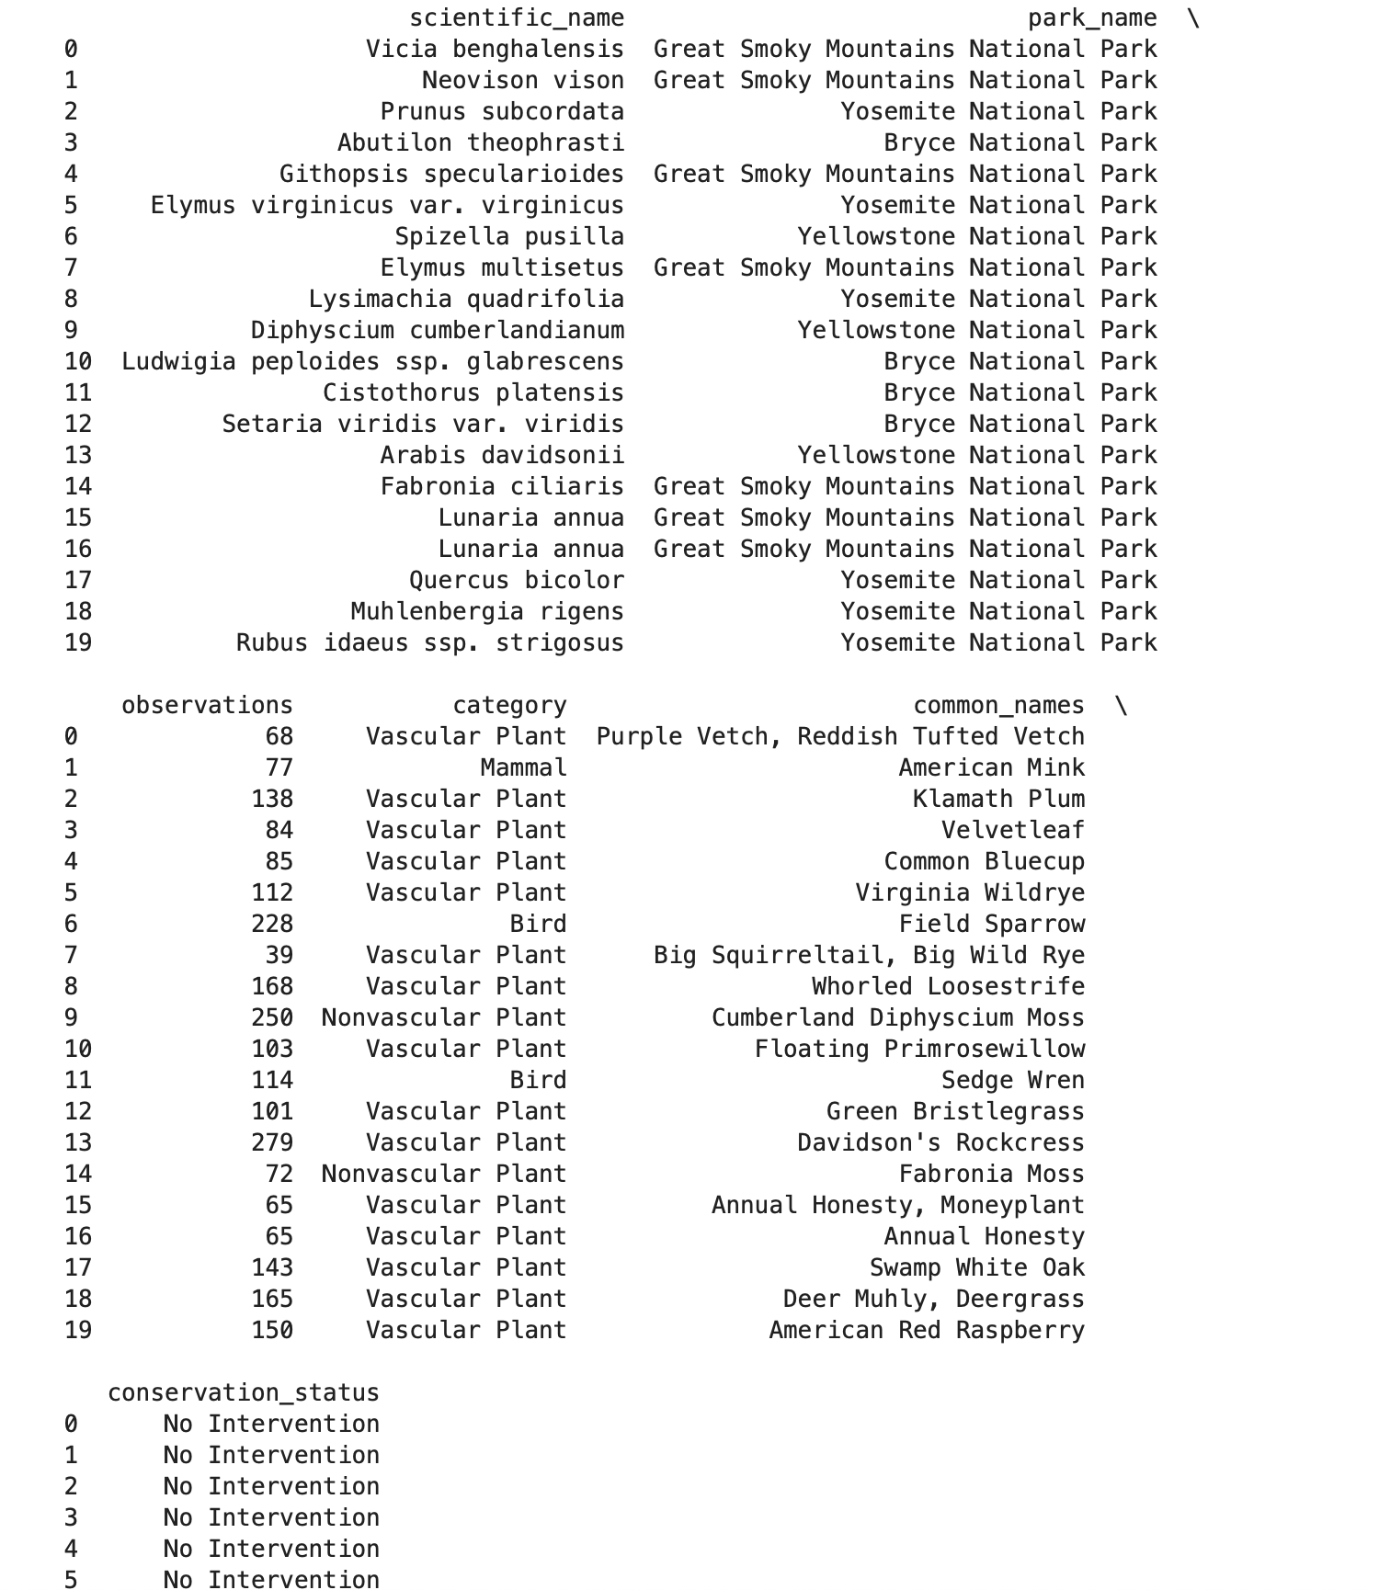
Dataset Overview
Data from 4 national parks: Great Smoky Mountains, Yosemite, Bryce, and Yellowstone
species_info.csv (5,824 records): category, scientific_name, common_names, conservation_status
observations.csv (23,296 records): scientific_name, park_name, observation
Merged on scientific_name to form biodiversity dataset

Slide 3
Data Cleaning & Preparation:
Removed 15 duplicate rows from observations.csv
Merged species and observation datasets on scientific_name
96% missing values in conservation_status replaced with “No Intervention”
Extracted common names like ‘Foxes’, ‘Osprey’

Slide 4
Statistical Test: Species vs Conservation Status:
Is there a statistically significant relationship between species category and conservation status? * chi-square test: chi-square statistic: 3130.22 degree of freedom: 24 p-value: 0.000 Result: From this, we can accept the hypothesis that there is a statistically significant relationship between species category and their conservation status.

Slide 5

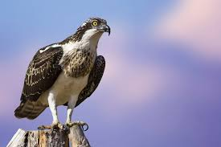
Key Findings:
Species composition relatively even across parks
Yellowstone had the highest number of species
All parks had equal amounts of protected species per category
Most common specie is Vascular Plant, followed by Mammals and Birds.
Mammals and Birds had the highest count of endangered specie. With Foxes and Osprey being the most endangered

Slide 6
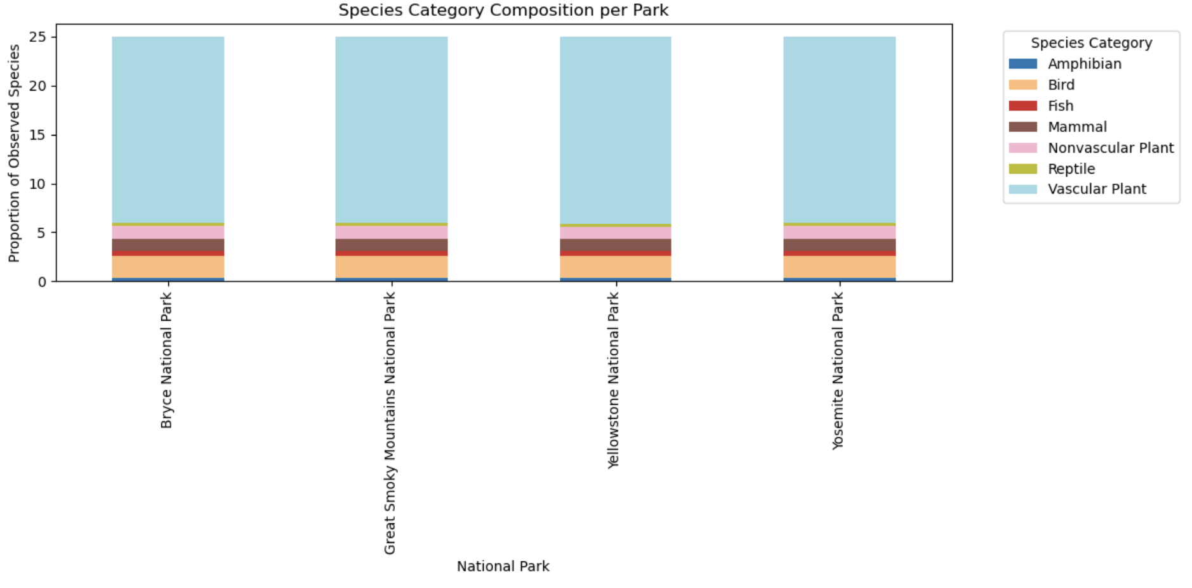
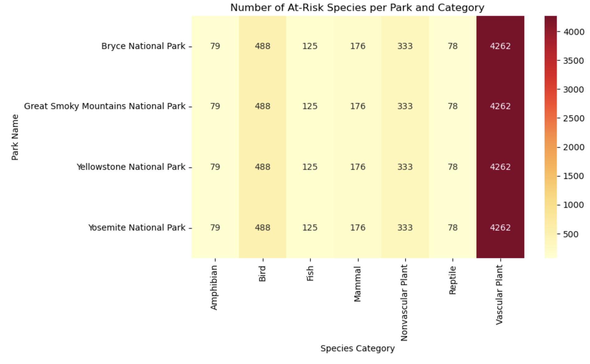
Visuals Insights
Bar chart:
composition of species per park
Heat map:
distribution of at risk-species across parks

Slide 7
Limitations:
Common names were simplified using only last words in column. Some species may be under or over-counted
Observation reflect species sighting not actual population estimates
Trends are static and do not reflect current conditions since the data isn’t a time series
The chi-square test assumes independence and a large enough sample per category

Slide 8
Recommendations/Next step:
Deeper classification of species using taxonomy or common name standardization.
Deeper dive into lesser-observed specie groups

